Slide 1
Chapter 9: Virtual Memory

Slide 2
Chapter 9: Virtual Memory
Background
Demand Paging
Copy-on-Write
Page Replacement
Allocation of Frames
Thrashing
Memory-Mapped Files
Allocating Kernel Memory
Other Considerations

Slide 3
Background
Virtual memory – separation of user logical memory from physical memory.
Only part of the program needs to be in memory for execution
Logical address space can therefore be much larger than physical address space
Allows address spaces to be shared by several processes
Allows for more efficient process creation
Virtual memory can be implemented via:
Demand paging
Demand segmentation

Slide 4
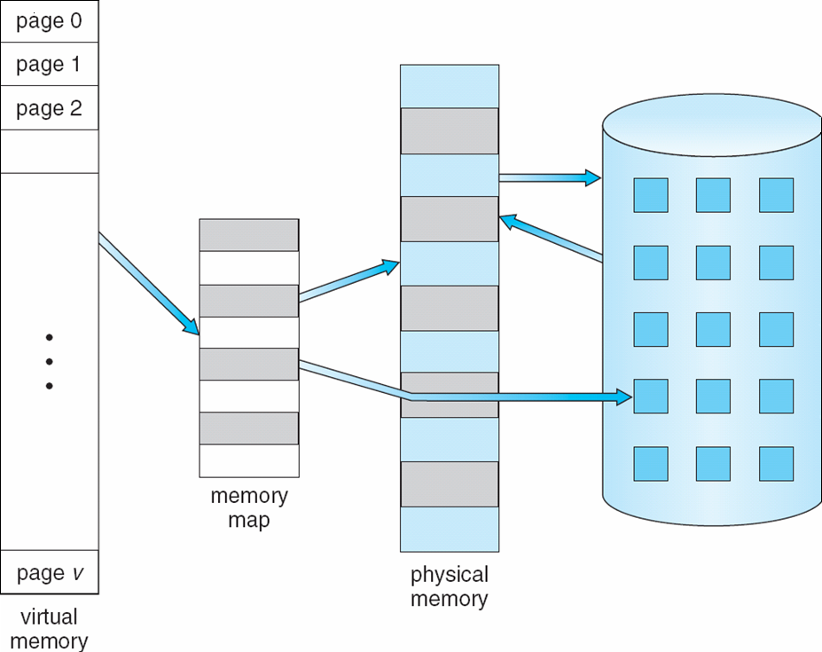
Virtual Memory That is Larger Than Physical Memory
⇒

Slide 5

Virtual-address Space

Slide 6
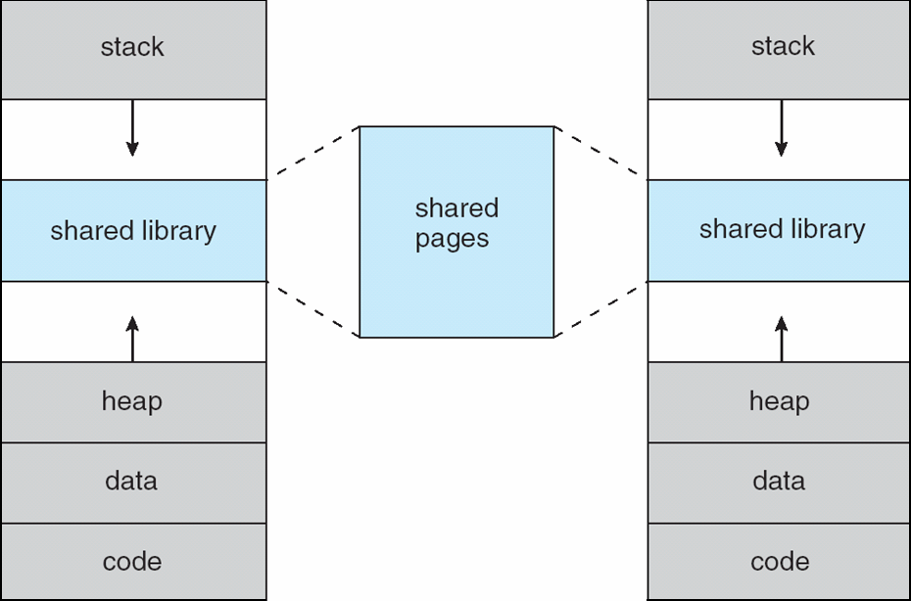
Shared Library Using Virtual Memory

Slide 7
Demand Paging
Bring a page into memory only when it is needed
Less I/O needed
Less memory needed
Faster response
More users
Page is needed ⇒ reference to it
invalid reference ⇒ abort
not-in-memory ⇒ bring to memory
Lazy swapper – never swaps a page into memory unless page will be needed
Swapper that deals with pages is a pager

Slide 8
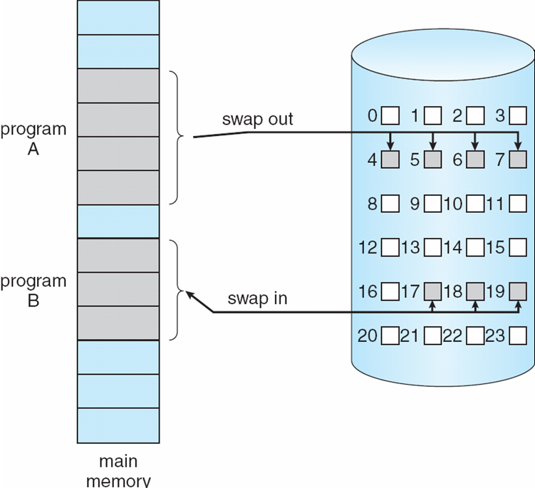
Transfer of a Paged Memory to Contiguous Disk Space

Slide 9
Valid-Invalid Bit
With each page table entry a valid–invalid bit is associated (v ⇒ in-memory, i ⇒ not-in-memory)
Initially valid–invalid bit is set to i on all entries
Example of a page table snapshot:
During address translation, if valid–invalid bit in page table entry
is i ⇒ page fault
Frame #
valid-invalid bit
v
v
v
v
i
….
i
i
page table

Slide 10
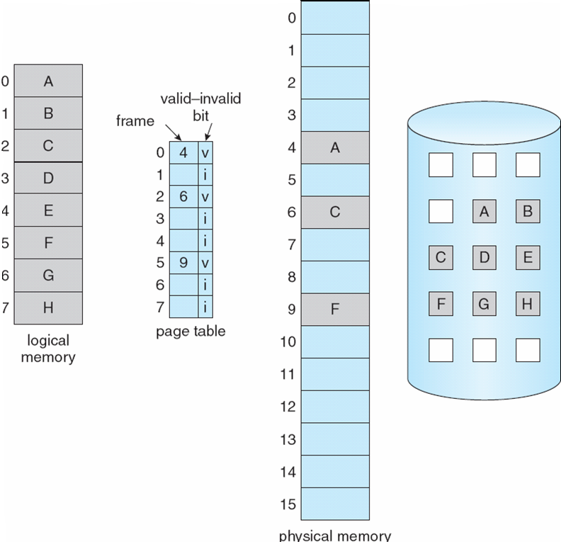
Page Table When Some Pages Are Not in Main Memory

Slide 11
Page Fault
If there is a reference to a page, first reference to that page will trap to operating system:
page fault
Operating system looks at another table to decide:
Invalid reference ⇒ abort
Just not in memory
Get empty frame
Swap page into frame
Reset tables
Set validation bit = v
Restart the instruction that caused the page fault

Slide 12
Page Fault (Cont.)
Restart instruction
block move
auto increment/decrement location

Slide 13

Steps in Handling a Page Fault

Slide 14
Performance of Demand Paging
Page Fault Rate 0 ≤ p ≤ 1.0
if p = 0 no page faults
if p = 1, every reference is a fault
Effective Access Time (EAT)
EAT = (1 – p) x memory access
+ p (page fault overhead
+ swap page out
+ swap page in
+ restart overhead
)

Slide 15
Demand Paging Example
Memory access time = 200 nanoseconds
Average page-fault service time = 8 milliseconds
1 millisecond = 1,000 microseconds = 1,000,000 nanoseconds
EAT = (1 – p) x 200 + p (8 milliseconds)
= (1 – p) x 200 + p x 8,000,000
= 200 + p x 7,999,800
If one access out of 1,000 causes a page fault, then
EAT = 8.2 microseconds.
This is a slowdown by a factor of 40!!

Slide 16
Process Creation
Virtual memory allows other benefits during process creation:
- Copy-on-Write
- Memory-Mapped Files (later)

Slide 17
Copy-on-Write
Copy-on-Write (COW) allows both parent and child processes to initially share the same pages in memory If either process modifies a shared page, only then is the page copied
COW allows more efficient process creation as only modified pages are copied
Free pages are allocated from a pool of zeroed-out pages

Slide 18
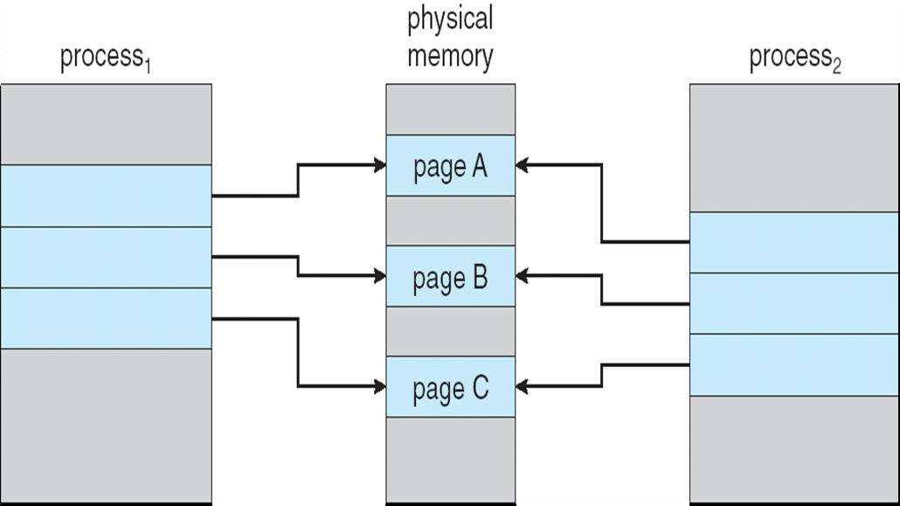
Before Process 1 Modifies Page C

Slide 19
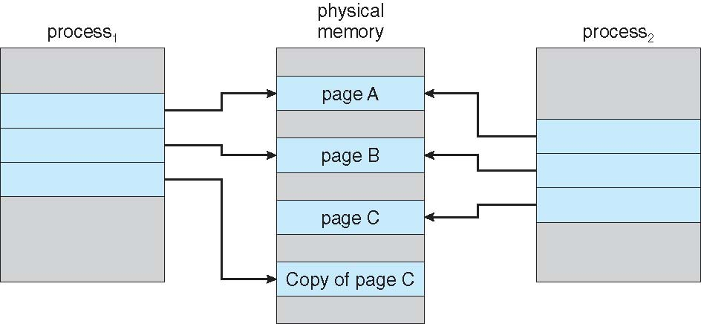
After Process 1 Modifies Page C

Slide 20
What happens if there is no free frame?
Page replacement – find some page in memory, but not really in use, swap it out
algorithm
performance – want an algorithm which will result in minimum number of page faults
Same page may be brought into memory several times

Slide 21
Page Replacement
Prevent over-allocation of memory by modifying page-fault service routine to include page replacement
Use modify (dirty) bit to reduce overhead of page transfers – only modified pages are written to disk
Page replacement completes separation between logical memory and physical memory – large virtual memory can be provided on a smaller physical memory

Slide 22
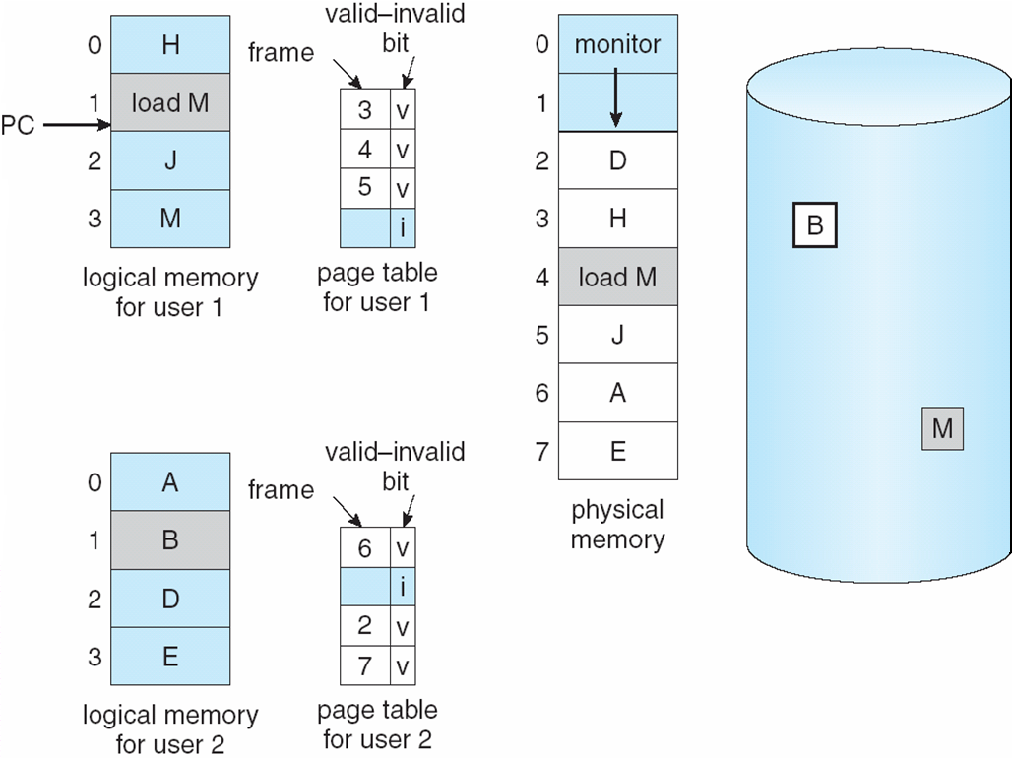
Need For Page Replacement

Slide 23
Basic Page Replacement
Find the location of the desired page on disk
Find a free frame: - If there is a free frame, use it - If there is no free frame, use a page replacement algorithm to select a victim frame
Bring the desired page into the (newly) free frame; update the page and frame tables
Restart the process

Slide 24
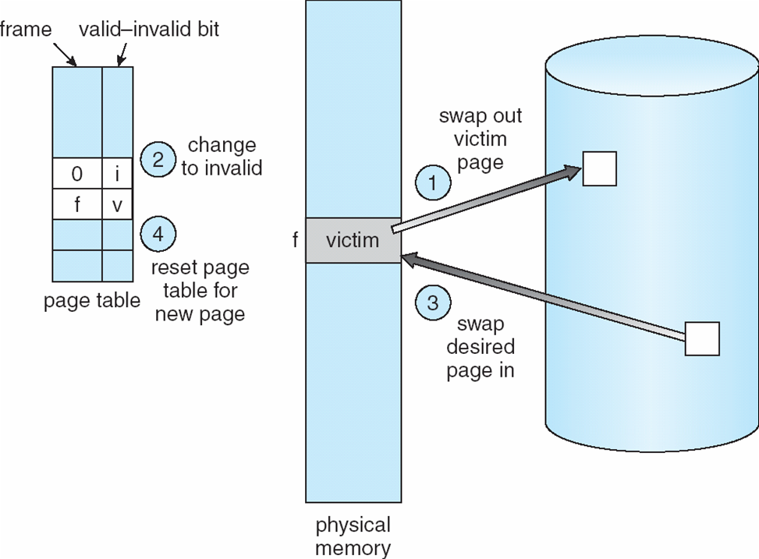
Page Replacement

Slide 25
Page Replacement Algorithms
Want lowest page-fault rate
Evaluate algorithm by running it on a particular string of memory references (reference string) and computing the number of page faults on that string
In all our examples, the reference string is
1, 2, 3, 4, 1, 2, 5, 1, 2, 3, 4, 5

Slide 26
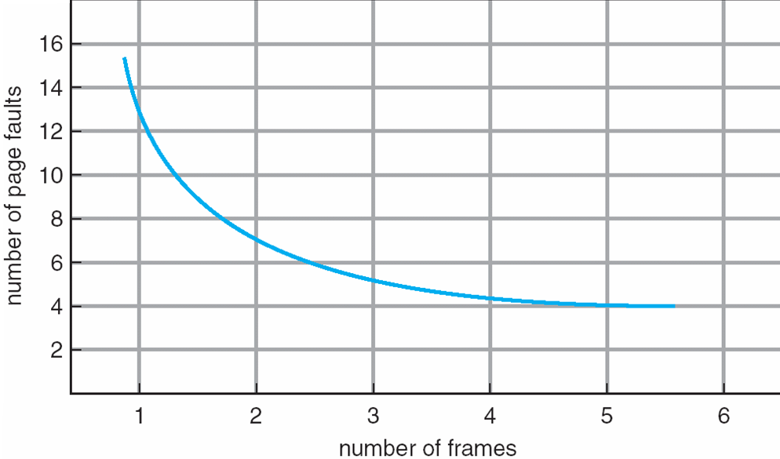
Graph of Page Faults Versus The Number of Frames

Slide 27
First-In-First-Out (FIFO) Algorithm
Reference string: 1, 2, 3, 4, 1, 2, 5, 1, 2, 3, 4, 5
3 frames (3 pages can be in memory at a time per process)
4 frames
Belady’s Anomaly: more frames ⇒ more page faults
1
1
4
5
2
2
1
3
9 page faults
3
3
2
4
1
1
5
4
2
2
1
5
10 page faults
3
3
2
4
4
3

Slide 28
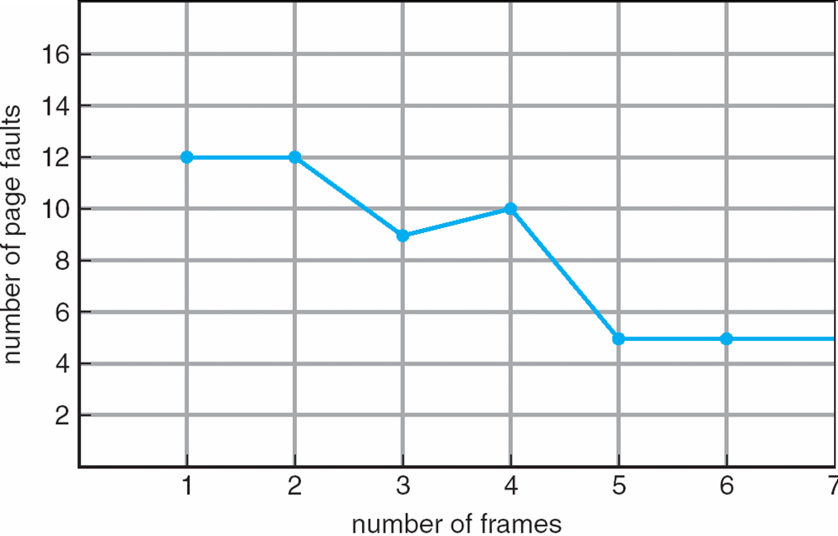
FIFO Illustrating Belady’s Anomaly

Slide 29
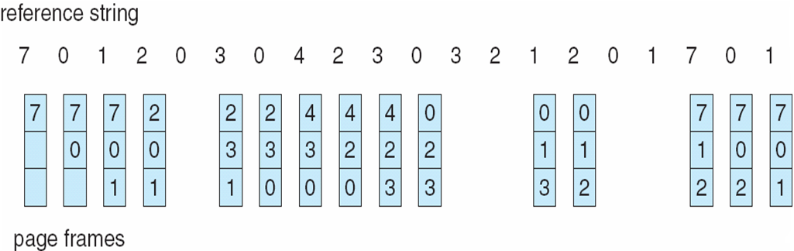
FIFO Page Replacement

Slide 30
Optimal Algorithm
Replace page that will not be used (in the future) for longest period of time
4 frames example
1, 2, 3, 4, 1, 2, 5, 1, 2, 3, 4, 5
How do you know this?
Used for measuring how well your algorithm performs
1
2
6 page faults
3
4
4
5

Slide 31
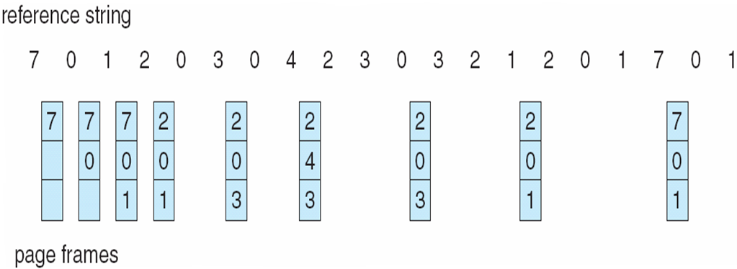
Optimal Page Replacement

Slide 32
Least Recently Used (LRU) Algorithm
Reference string: 1, 2, 3, 4, 1, 2, 5, 1, 2, 3, 4, 5
Counter implementation
Every page entry has a counter; every time page is referenced through this entry, copy the clock into the counter
When a page needs to be changed, look at the counters to determine which are to change
1
1
1
1
5
2
2
2
2
2
3
5
5
4
4
4
4
3
3
3

Slide 33
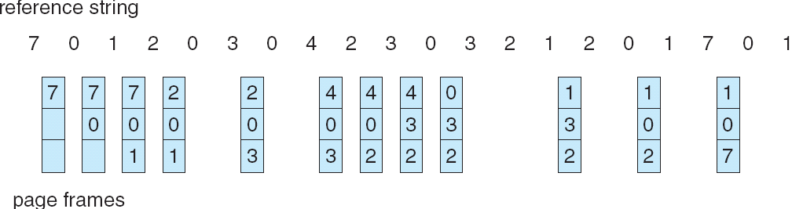
LRU Page Replacement

Slide 34
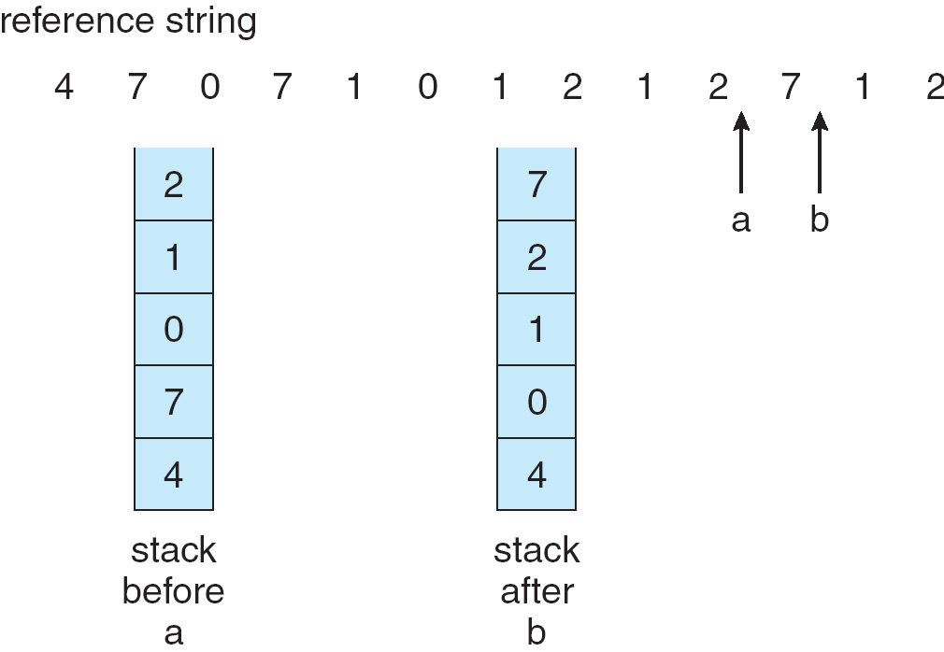
LRU Algorithm (Cont.)
Stack implementation
Page referenced → move it to the top
No search for replacement

Slide 35
LRU Approximation Algorithms
Reference bit
With each page associate a bit, initially = 0
When page is referenced bit set to 1
Replace the one which is 0 (if one exists)
We do not know the order, however
Second chance
Need reference bit
Clock replacement
If page to be replaced (in clock order) has reference bit = 1 then:
set reference bit 0
leave page in memory
replace next page (in clock order), subject to same rules

Slide 36
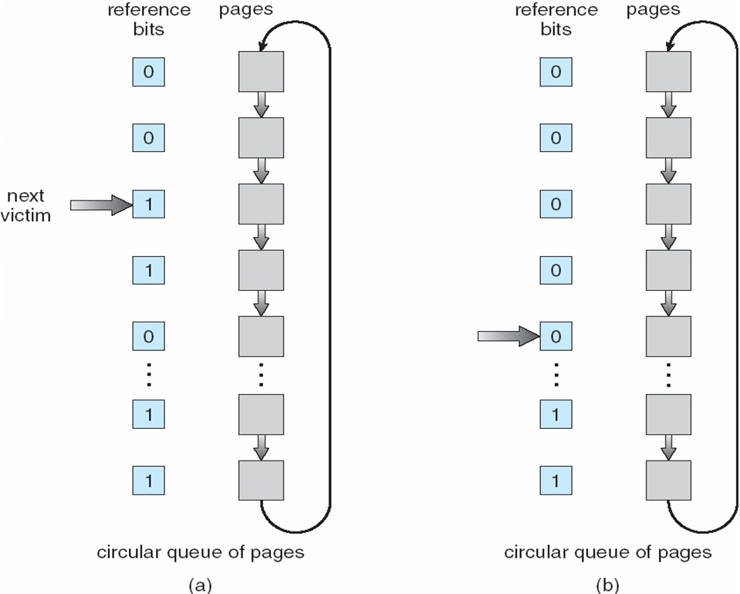
Second-Chance (clock) Page-Replacement Algorithm

Slide 37
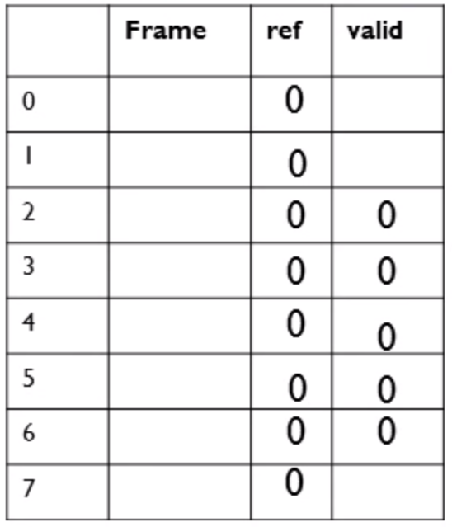

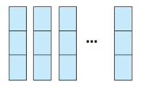
Second-Chance Page Replacement Algorithm

Slide 38
Counting Algorithms
Keep a counter of the number of references that have been made to each page
LFU Algorithm: replaces page with smallest count
MFU Algorithm: based on the argument that the page with the smallest count was probably just brought in and has yet to be used

Slide 39
Allocation of Frames
Each process needs minimum number of pages
Example: IBM 370 – 6 pages to handle SS MOVE instruction:
instruction is 6 bytes, might span 2 pages
2 pages to handle from
2 pages to handle to
Two major allocation schemes
fixed allocation
priority allocation

Slide 40
Fixed Allocation
Equal allocation – For example, if there are 100 frames and 5 processes, give each process 20 frames.
Proportional allocation – Allocate according to the size of process

Slide 41
Priority Allocation
Use a proportional allocation scheme using priorities rather than size
If process P_{i} generates a page fault,
select for replacement one of its frames
select for replacement a frame from a process with lower priority number

Slide 42
Global vs. Local Allocation
Global replacement – process selects a replacement frame from the set of all frames; one process can take a frame from another
Local replacement – each process selects from only its own set of allocated frames

Slide 43
Thrashing
If a process does not have “enough” pages, the page-fault rate is very high. This leads to:
low CPU utilization
operating system thinks that it needs to increase the degree of multiprogramming
another process added to the system
Thrashing ≡ a process is busy swapping pages in and out

Slide 44
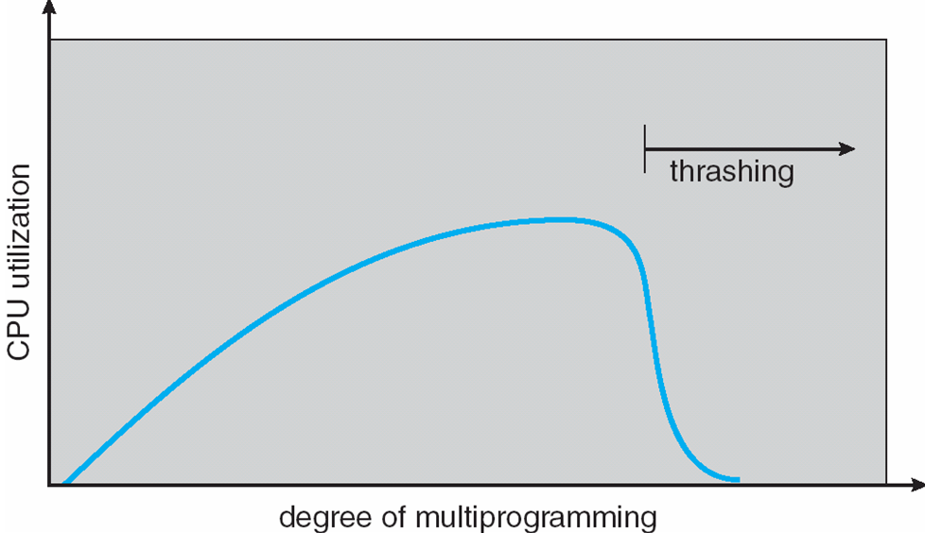
Thrashing (Cont.)

Slide 45
Demand Paging and Thrashing
Why does demand paging work? Locality model
Process migrates from one locality to another
Localities may overlap
Why does thrashing occur? Σ size of locality > total memory size

Slide 46
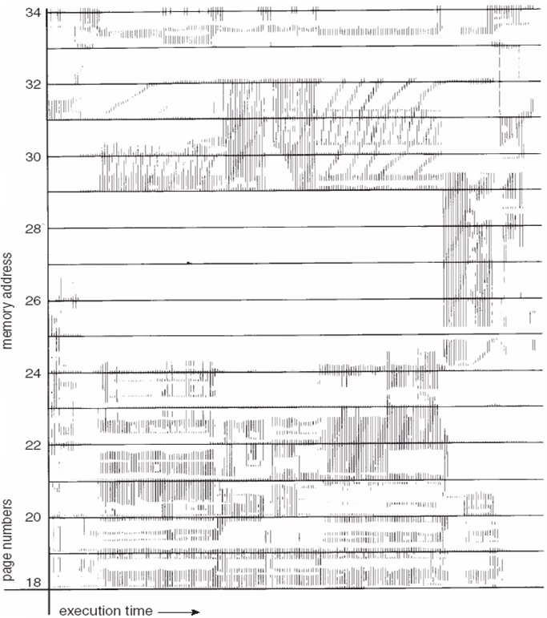
Locality In A Memory-Reference Pattern

Slide 47
Working-Set Model
Δ ≡ working-set window ≡ a fixed number of page references Example: 10,000 instruction
WSS_{i} (working set of Process P_{i}) = total number of pages referenced in the most recent Δ (varies in time)
if Δ too small will not encompass entire locality
if Δ too large will encompass several localities
if Δ = ∞ ⇒ will encompass entire program
D = Σ WSS_{i} ≡ total demand frames
if D > m ⇒ Thrashing
Policy if D > m, then suspend one of the processes

Slide 48
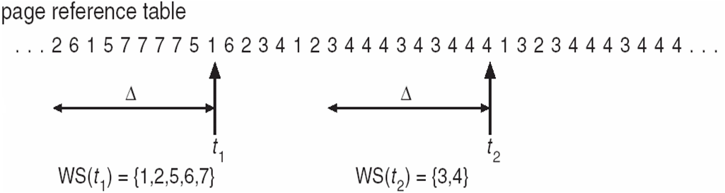
Working-set model

Slide 49
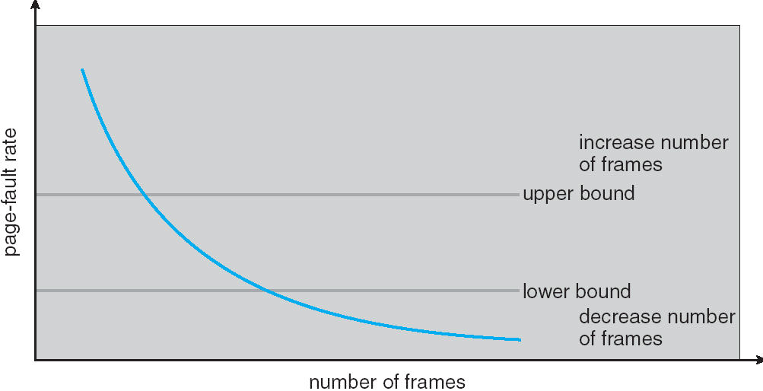
Page-Fault Frequency Scheme
Establish “acceptable” page-fault rate
If actual rate too low, process loses frame
If actual rate too high, process gains frame

Slide 50
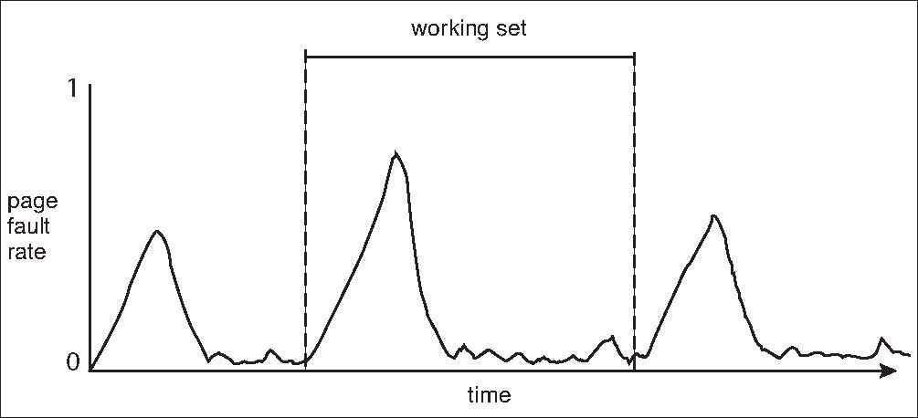
Working Sets and Page Fault Rates

Slide 51
Allocating Kernel Memory
Treated differently from user memory
Often allocated from a free-memory pool
Kernel requests memory for structures of varying sizes
Some kernel memory needs to be contiguous

Slide 52
Buddy System
Allocates memory from fixed-size segment consisting of physically-contiguous pages
Memory allocated using power-of-2 allocator
Satisfies requests in units sized as power of 2
Request rounded up to next highest power of 2
When smaller allocation needed than is available, current chunk split into two buddies of next-lower power of 2
Continue until appropriate sized chunk available

Slide 53
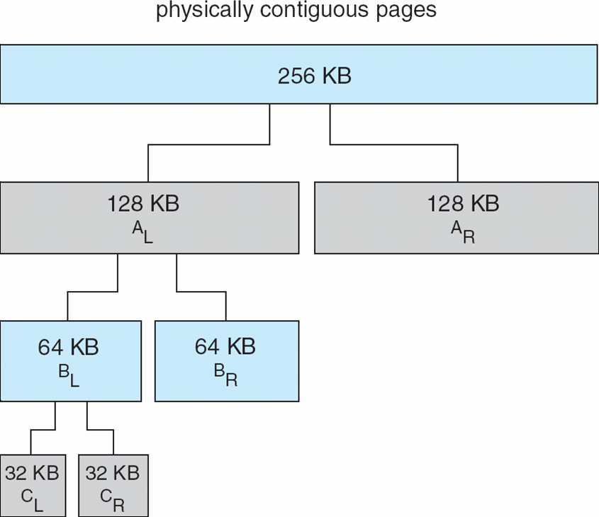
Buddy System Allocator

Slide 54
Slab Allocator
Alternate strategy
Slab is one or more physically contiguous pages
Cache consists of one or more slabs
Single cache for each unique kernel data structure
Each cache filled with objects – instantiations of the data structure
When cache created, filled with objects marked as free
When structures stored, objects marked as used
If slab is full of used objects, next object allocated from empty slab
If no empty slabs, new slab allocated
Benefits include no fragmentation, fast memory request satisfaction

Slide 55
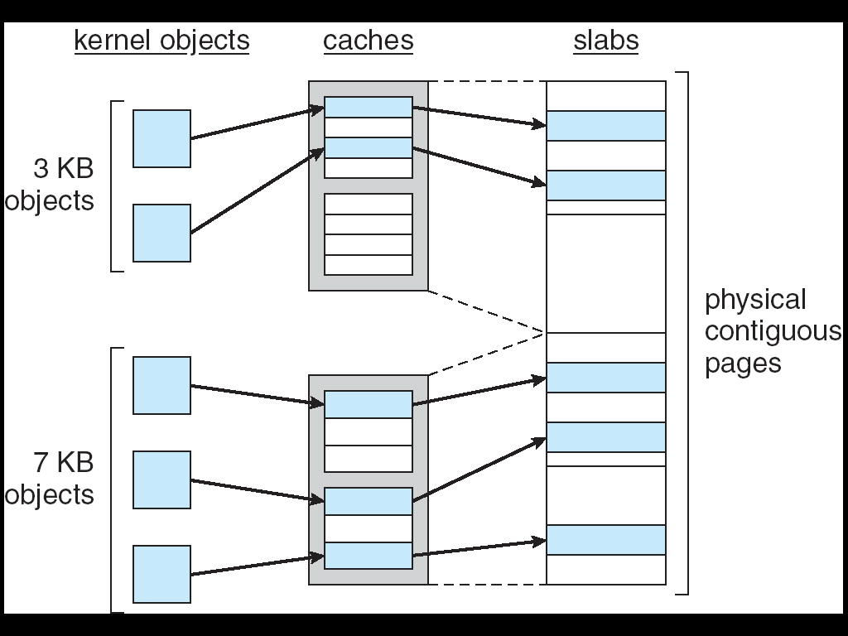
Slab Allocation

Slide 56
Other Issues -- Prepaging
Prepaging
To reduce the large number of page faults that occurs at process startup
Prepage all or some of the pages a process will need, before they are referenced
But if prepaged pages are unused, I/O and memory was wasted

Slide 57
Other Issues – Page Size
Page size selection must take into consideration:
fragmentation
table size
I/O overhead
locality

Slide 58
Other Issues – TLB Reach
TLB Reach - The amount of memory accessible from the TLB
TLB Reach = (TLB Size) X (Page Size)
Ideally, the working set of each process is stored in the TLB
Otherwise there is a high degree of page faults
Increase the Page Size
This may lead to an increase in fragmentation as not all applications require a large page size
Provide Multiple Page Sizes
This allows applications that require larger page sizes the opportunity to use them without an increase in fragmentation

Slide 59
Other Issues – Program Structure
Program structure
int[128,128] data;
Each row is stored in one page
Program 1
for (int j = 0; j <128; j++) for (int i = 0; i < 128; i++) data[i,j] = 0;
128 x 128 = 16,384 page faults
Program 2
for (int i = 0; i < 128; i++) for (int j = 0; j < 128; j++) data[i,j] = 0;
128 page faults

Slide 60
Other Issues – I/O interlock
I/O Interlock – Pages must sometimes be locked into memory
Consider I/O - Pages that are used for copying a file from a device must be locked from being selected for eviction by a page replacement algorithm

Slide 61
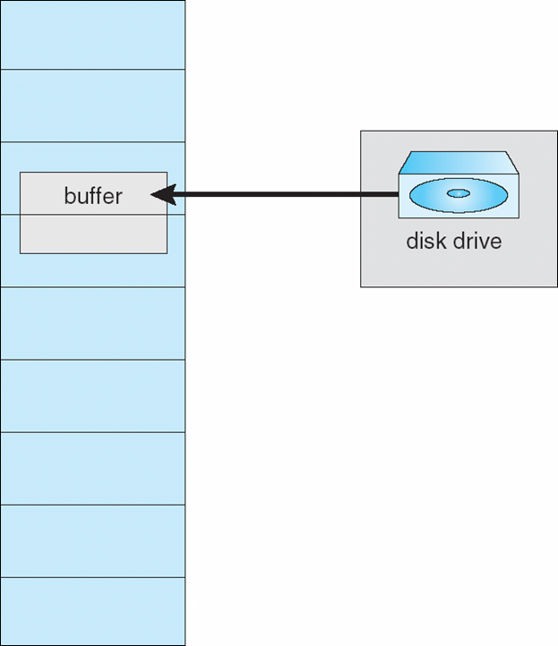
Reason Why Frames Used For I/O Must Be In Memory

Slide 62
End of Chapter 9

